Slide 1
NoSQL Database Performance Tuning for IoT Data
Cassandra Case Study
Lucas B. Dias (lecturer) – Ipea, University of Brasília
Maristela Holanda – University of Brasília
Ruben C. Huacarpuma – University of Brasília
Rafael T. de Sousa Jr – University of Brasília

Slide 2
IoT Data characteristics
May be classified as Big Data if the number of sensors or measurements are high and increasing [1].
Is a specific case of time series data [2].
Peculiar characteristics [3][4]:
Massive Data
Data is usually ordered
Time based data retrieval
Data rarely changes
IoT Data Expires

Slide 3
NoSQL Databases
NoSQL Databases are more suitable than relational databases for storing the IoT Data [5][6][7].
Cassandra database system has proved good performance and adequate for storing IoT Data [8].
Cassandra database system has characteristics both from Google BigTable and Amazon Dynamo. But is an independent system from those.

Slide 4
Research objective (this position paper)
To find a near-optimal configuration of database compaction, for IoT Data, in terms of response time and space used.
Cassandra database system was used.
Database compaction configuration evolves the tuning of its parameters.
Main metrics used to evaluate optimality are throughput, response time, and disk space used.

Slide 5
Related work
Lu and Xiaohui, 2016, studied one database compaction strategy of Cassandra and concluded that it is a remarkable database for storing time series [8].
Kona, 2016 and Ravu, 2016 executed and analysed the behavior of Cassandra in a high-intensive workload, comparing three database compaction strategies that existed then [9][10].
Sathvik, 2016 made performance tuning of Cassandra, but did not cope with database compaction parameters [11].
Our research differs from these studies because it considers the novel Time Window Compaction Strategy and it is specific for IoT Data.

Slide 6
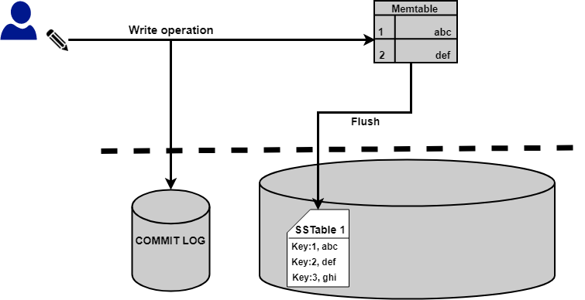
NoSQL database internals
Google Bigtable [13] defines an architecture in which data is only inserted (or upserted) and retrieved. Data is inserted in a Commit Log, for persistency purposes and in the memory, in structures called MemTables.

Slide 7
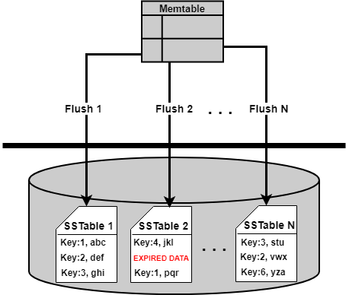
Cassandra Flush
A Flush is an operation where data goes from Memtable to disk, in structures called Sorted String Table (SSTables), which are immutable.
The flush occurs when
The Memtable is full enough
The Memtable is old enough
The user commands

Slide 8
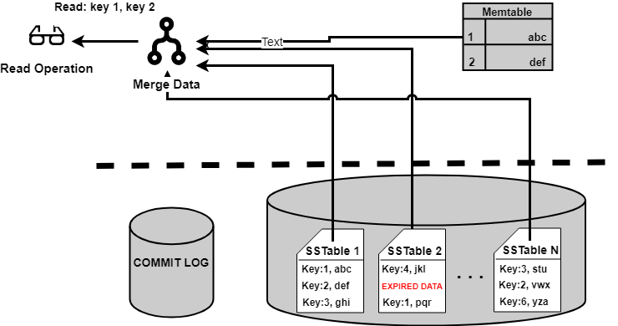
Cassandra Read Path
Data from only one column-family (table) may have several SSTables after many flushes. This compromises the Read operations, which tend to last longer.
If the same cell (register) of a columns family receives different values along different SSTables and a Read operation occur, the system must merge these values implicitly before presenting to the user.

Slide 9
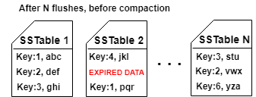
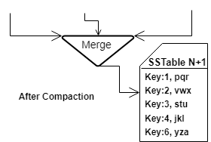
Database Compaction
In order to avoid the Read Path problem, SSTables must be merged periodically. This merge is called database compaction but it does not evolve any compress or data compaction algorithms.

Slide 10
Database Compaction Strategies
Cassandra has four different strategies. Two of then related to time series data. Both merge the SSTables by its age (the difference between now and when data was inserted).
Date Tiered Compaction Strategy (DTCS)
Time Window Compaction Strategy (TWCS)
The main difference is that in TWCS case, as long as the time window has not been reached, is uses another compaction strategy, compacting SSTables that have the same size, which is Size Tiered Compaction Strategy (STCS).
It means DTCS performs less compaction operations, however, queries tend to have worse response time.

Slide 11
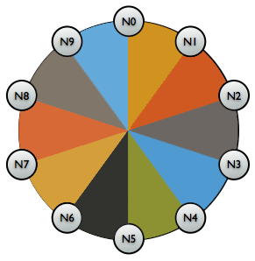
Test Bed
10 nodes with equal capacity
One Intel Xeon Core
3.2GB RAM memory
7200 rpm spinning disks with 50GB
Linux with Ubuntu distribution
Cassandra version 3.11.1
One extra node generated data with the same configuration. Cassandra 4.0 – alpha.

Slide 12
IoT Environment
All data had an 60 minutes TTL plus 30 minute grace period. Data get expired after 90 minutes.
90% of upsert operation (Inserts or Updates)
10% read queries
4% – select * from iot_data_dt where device_id = ?
3% – select * from iot_data_dt where device_id = ? and service_name = ? and observation_time = ?
3% – select device_id, avg(observed_value) FROM iot_data_dt where device_id = ?

Slide 13
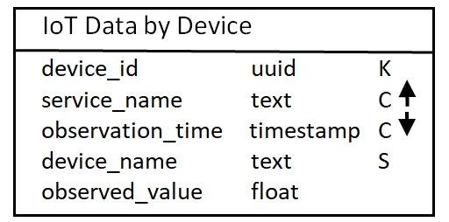
Test scenario: Data model (Chebotko notation)
K: Partition Key
C: Clustering Key, ascending or descending
S: Static column (stored once for each Partition Key)

Slide 14
Test scenario: volume
Tool used was Cassandra Stress Tool, version 4.0 (alpha) with some customization.
Volume of Data:
RI = OP∗IR∗TS∗OV
RI: rows inserted; OP: Operations; TS: Time Series per device; OV: Observation Values.
RI = 2,000,000∗0.9∗5∗60 = 540,000,000
Remind: Data gets expired after 90 minutes, so never the 540M rows coexisted in database. Every stress execution lasted more than 120 minutes.

Slide 15
Test scenario: two test cases
The first was to compare DTCS versus TWCS. This test was performed with default compaction parameters for both cases.
The second test case was, after finding the more performatic of two strategies, find a near-optimal configuration for this scenario.

Slide 16
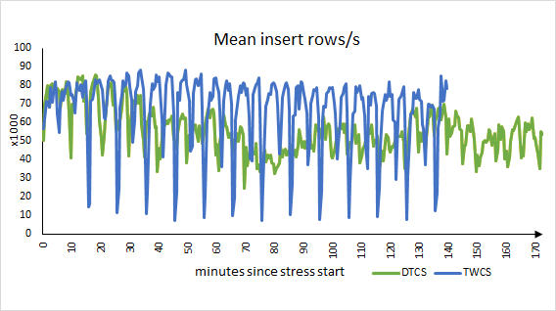
Results: DTCS vs TWCS
This is the mean between all nodes and between six executions
Rows per second | DTCS | TWCS
Mean | 55466 | 66771
Median | 54885 | 73488
p95 | 78538 | 84523

Slide 17
Results: DTCS vs TWCS – time
Total time elapsed for the 600M Operations (540M writes plus 60M reads)
Strategy | Average Time | Std. Dev. (%) | Speedup (TWCS / DTCS)
DTCS | 02h41m48 | 0,71%
TWCS | 02h14m57 | 0,67% | 1,20

Slide 18
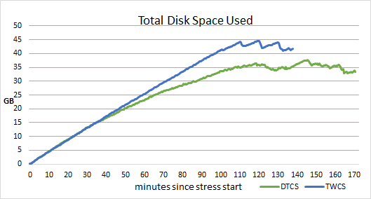
Results – DTCS vs TWCS – Space used
Total space presented is the sum of all 10 nodes.
At minute 90 data starts to get expired, and after minute 110 space stops increasing.

Slide 19
DTCS vs TWCS – results analysis
TWCS has shown 20% faster than DTCS in response time, to perform the same operations.
TWCS has better throughput and better latency.
As many computational problems known, there is a trade-off between time and space. DTCS uses less space: in average, disk space used is 5.5% higher in TWCS. The maximum difference noticed was in 18.4% more space used by TWCS.
We confirm the decision of Cassandra community to mark DTCS as deprecated and to recommend TWCS to replace it. Moreover, TWCS is more simple to configure than DTCS.

Slide 20
TWCS configuration - parameters
TWCS has shown to be por performatic, so we tried to find a near optimal configuration for the IoT scenario.
TWCS has only two parameters of his own, and both related to the same magnitude: the windows size.
compaction window size: the size, in terms of time, that SSTables will be merged. After this time has passed, SSTabels will not be compacted anymore.
compaction window unit: may be MINUTES, HOURS or DAYS.
14 window sizes were tested, from 1 to 240. For visualization issues, not all are shown in every graphic.

Slide 21
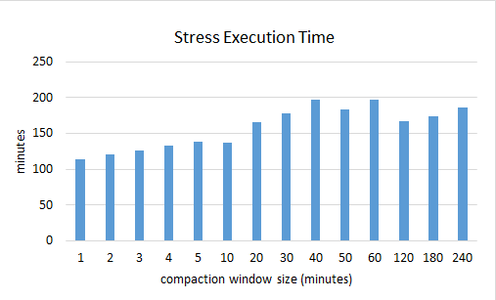
TWCS – execution times
The faster is the one with the smaller Time Window (1 minute)

Slide 22
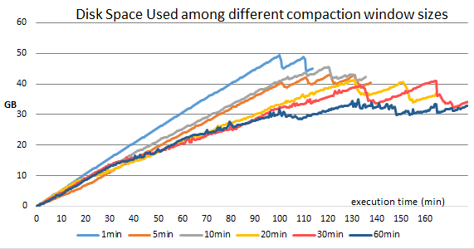
TWCS – Disk Space used
For visualization purposes not all 14 series are shown.
But after 60 minutes space used does not decrease.
Once more, the fastest uses more disk space.

Slide 23
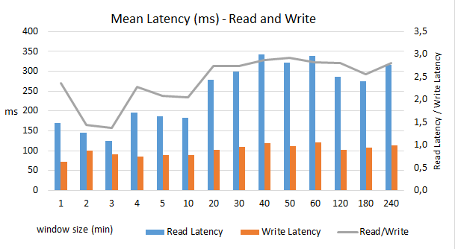
TWCS – Mean latency (read an write)
The lowest Write Latency is in the most efficient window size
The lowest read / write latency ratio is in the 3 minute window size.
This test case had 10% read ops.
Probably with more read ops, the optimal config will be closer to the 3 minute window size.

Slide 24
Conclusion - TWCS
In this scenario TWCS fastest configuration was the lowest possible: 1 minute window size. We recommend the Cassandra Community to allow smaller windows sizes, because probably in some scenarios, smaller window sizes may be more efficient.
The time and space trade-off remains. The fastest test config (1- minute) was shown to be the more disk consuming, in peak it used 40,8% more space than the lowest disk user, that was 60-minutes. However this config lasted 72.6% more to perform the same operations)

Slide 25
Considerations and future/ongoin work
Tests must be confirmed in larger test beds.
Different column-family models must be tested to confirm results.
Tests must be made with real IoT Data to confirm results.
The creation of an auto-tuning component of database compaction parameters is in course, firstly with TWCS. With this results we may start to design the performance model for this component.

Slide 26
References
[1] Ramaswamy, L., Lawson, V., and Gogineni, S. V. (2013). Towards a quality-centric big data architecture for federated sensor services. In Big Data (BigData Congress), 2013 IEEE International Congress on, pages 86–93. IEEE
[2] Ramesh, D., Sinha, A., and Singh, S. (2016). Data modelling for discrete time series data using Cassandra and MongoDB. In 2016 3rd International Conference on Recent Advances in Information Technology (RAIT), pages 598–601.
[3]Waddington, D. G. and Lin, C. (2016). A Fast Lightweight Time-Series Store for IoT Data. CoRR - Computing Research Repository. arXiv: 1605.01435. [4] Abu-Elkheir, M., Hayajneh, M., and Ali, N. (2013). Data Management for the Internet of Things: Design Primitives and Solution. Sensors, 13(11):15582–15612
[5] Vongsingthong, Suwimon and Smanchat, Sucha (2015). A Review of Data Management in Internet of Things. KKU Research Journal, pages 215–240.
[6] Ma, M., Wang, P., and Chu, C. H. (2013). Data Management for Internet of Things: Challenges, Approaches and Opportunities. In Green Computing and Communications (GreenCom), 2013 IEEE and Internet of Things (iThings/CPSCom), IEEE International Conference on and IEEE Cyber, Physical and Social Computing, pages 1144–1151.

Slide 27
[7] Zhu, S. (2015). Creating a NoSQL database for the Internet of Things : Creating a key-value store on the SensibleThings platform. PhD thesis, Mid Sweden University, Faculty of Science, Technology and Media, Department of Information and Communication systems, Sundsvall, Sweden.
[8] Lu, B. and Xiaohui, Y. (2016). Research on Cassandra data compaction strategies for time-series data. Journal of Computers, 11(6):504–513
[9] Kona, S. (2016). Compactions in Apache Cassandra : Performance Analysis of Compaction Strategies in Apache Cassandra. Master’s thesis, Blekinge Institute of Technology, Karlskrona, Sweden.
[10] Ravu, V. S. S. J. S. (2016). Compaction Strategies in Apache Cassandra : Analysis of Default Cassandra stress model. Master’s thesis, Blekinge Institute of Technology, Karlskrona, Sweden.
[11] Sathvik, K. (2016). Performance Tuning of Big Data Platform : Cassandra Case Study. PhD thesis, Blekinge Institute of Technology, Faculty of Computing, Department of Communication Systems, Karlskrona, Sweden.
[12] Chang, F., Dean, J., Ghemawat, S., Hsieh, W. C., Wallach, D. A., Burrows, M., Chandra, T., Fikes, A., and Gruber, R. E. (2008). Bigtable: A distributed storage system for structured data. ACM Transactions on Computer Systems (TOCS), 26(2):4.

Slide 28
Questions?
lucas@maurobenevides.com.br
All results data is in https://github.com/lucasbenevides/iotbds

